Slide 1
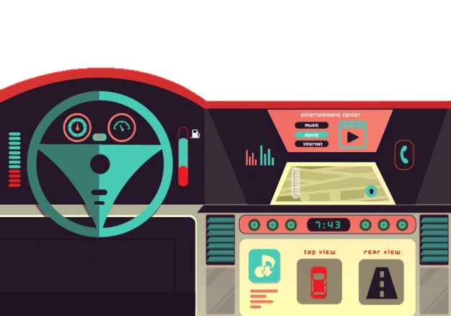
AutOS
Analysis Presentation
Fábio Magalhães – A75030
Rui Carvalho – A76279

Slide 2
AGENDA
Problem Statement
Constrains
Technical Constrains
Functional Requirements
Non-Functional Requirements
Specifications
System Overview
Gantt Chart

Slide 3
Problem Statement
All recent automobiles have an on-board computer, that assist the driving and the maintenance of the vehicle. It has become an accessory more and more indispensable, however it is still very expensive for the masses. Yet possible to install on older vehicles, it brings mechanical complications, and great monetary cost.
The Project’s goal is to develop an efficient, plug-n-play, inexpensive, functionality full on-board computer. I will be perfect companion to every road trip.
Apart from giving every basic information, the system will be able to report to the user every malfunction in the car.

Slide 4
Constraints
Constraints
Budget must be minimal.
Project developed by a team of two.
Project must meet the final deadline.
Technical Constraints
Raspberry Pi
Buildroot

Slide 5
Requirements
Functional Requirements
Get car information through OBD port
Show data on screen
Alert the user for malfunctions
Calculate road slope
Warn bad driver behaviour
Functional Requirements
Low Cost and low power.
User-friendly interface.
Plug’n’play
The system must have low latency.

Slide 6
Specifications
Hardware Specification
Raspberry Pi 3
LCD with touchscreen
SD Card Module
Bluetooth Module
OBD module
Accelerometer
Software Specification
Embedded Linux
C/C++ Language
Buildroot

Slide 7
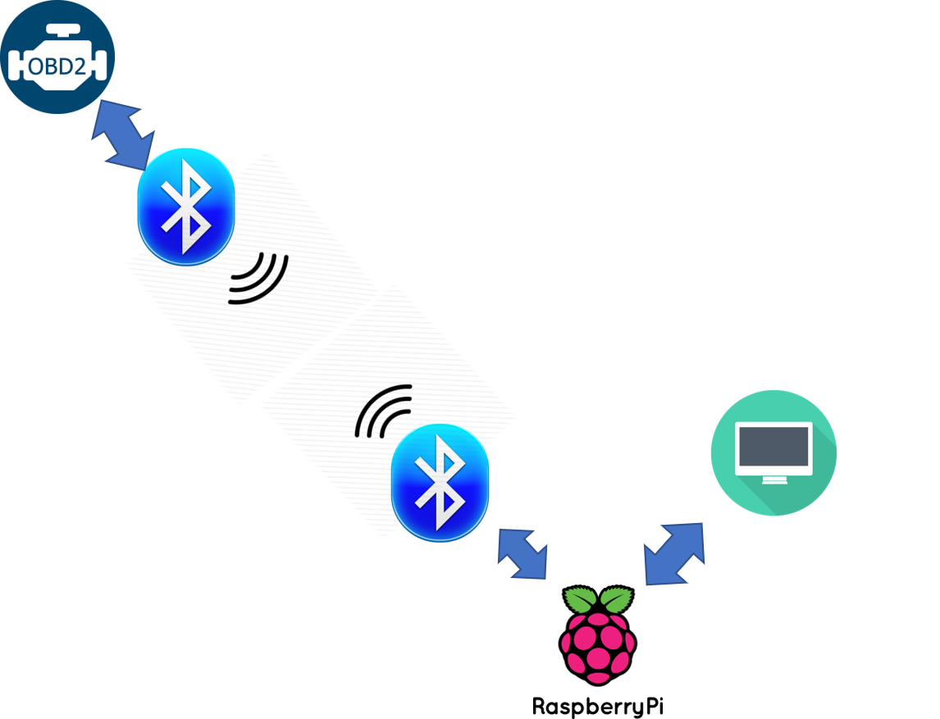

System overview

Slide 8
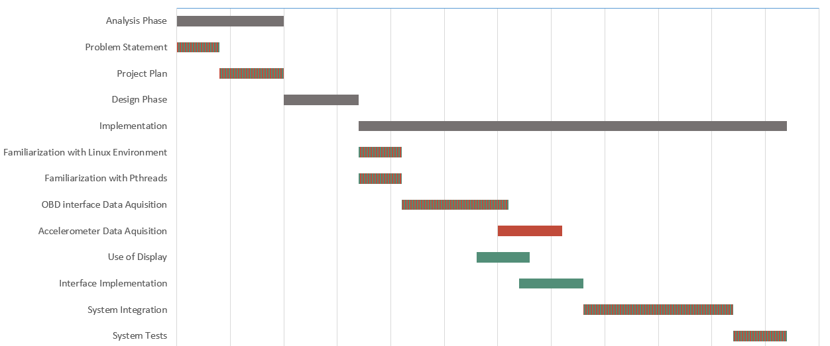
Gantt Chart
 | Fábio Magalhães
 | Rui Carvalho

